Slide 1
Exercise 3

Slide 2
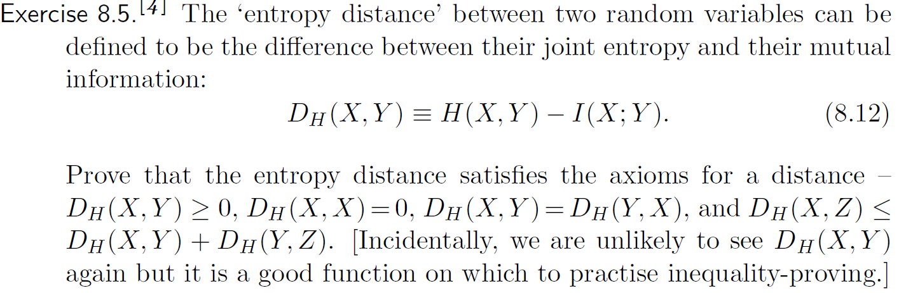
Prove it by information diagram.

Slide 3
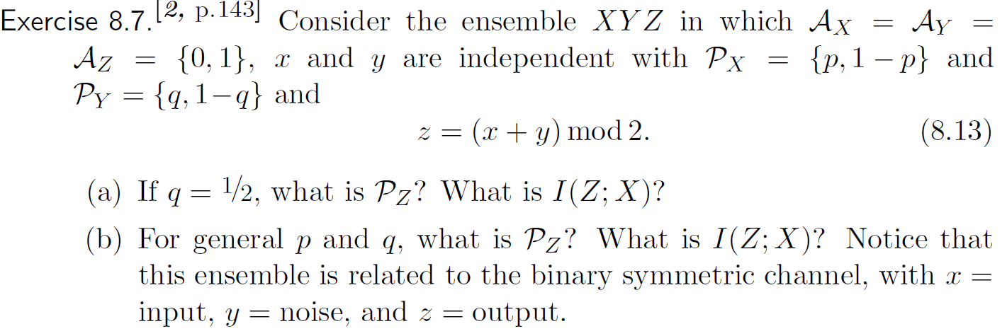
(a). By definition, compute the distribution of P(Z).
(b). I(Z;X) = H(Z)-H(Z|X) = H(Z) – H(X+Y|X) = H(Z) –H(Y|X) = H(Z) – H(Y)

Slide 4
By definition, it is trivial to compute these two probabilities.

Slide 5
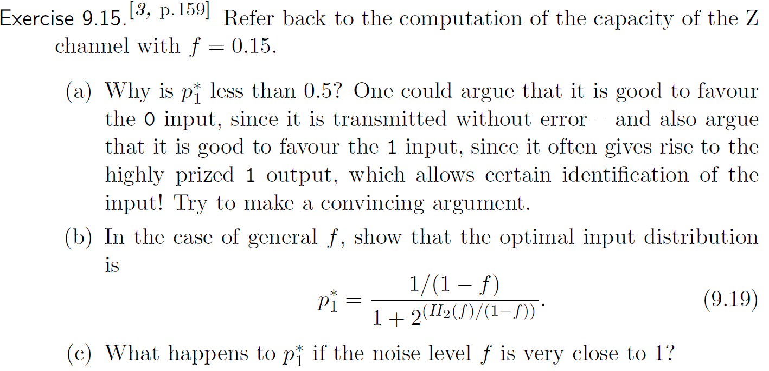

Slide 6
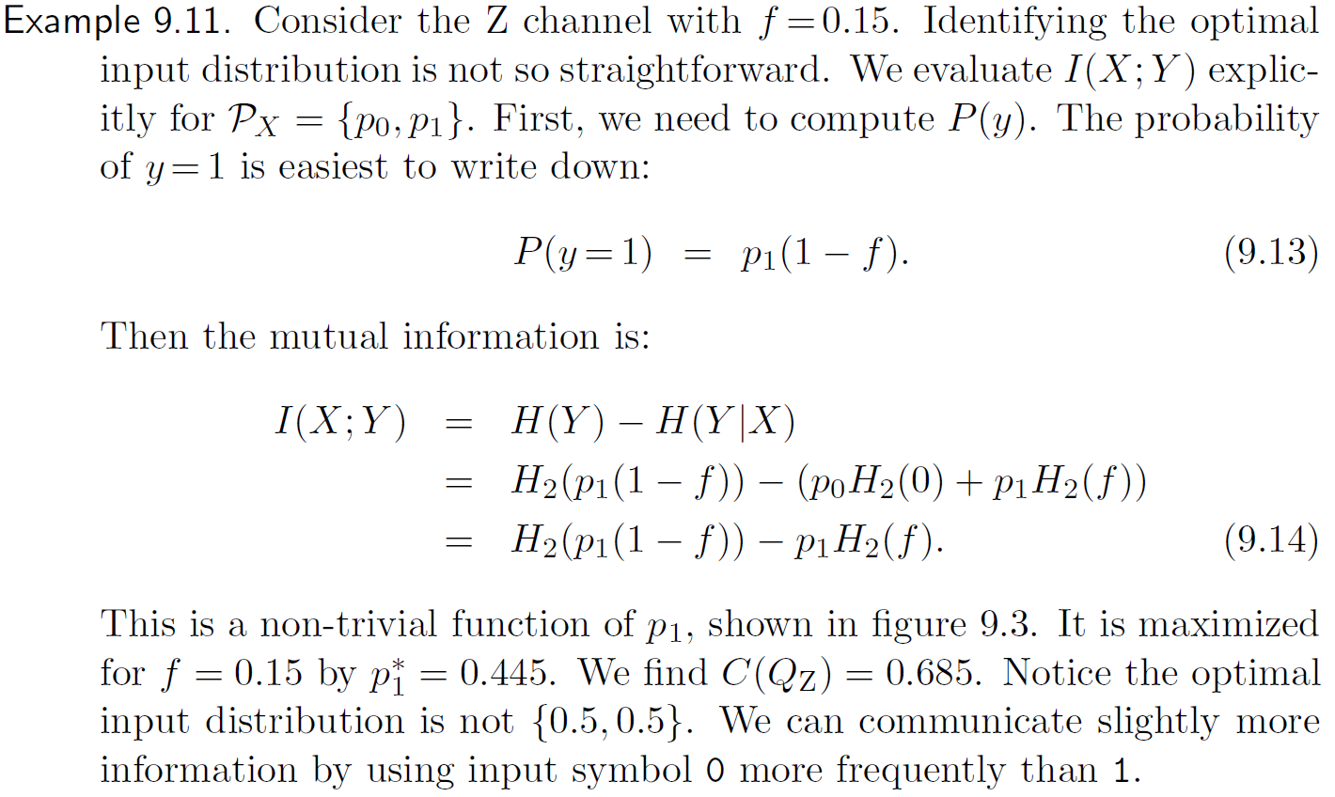
How to compute the capacity of Z-channel

Slide 7
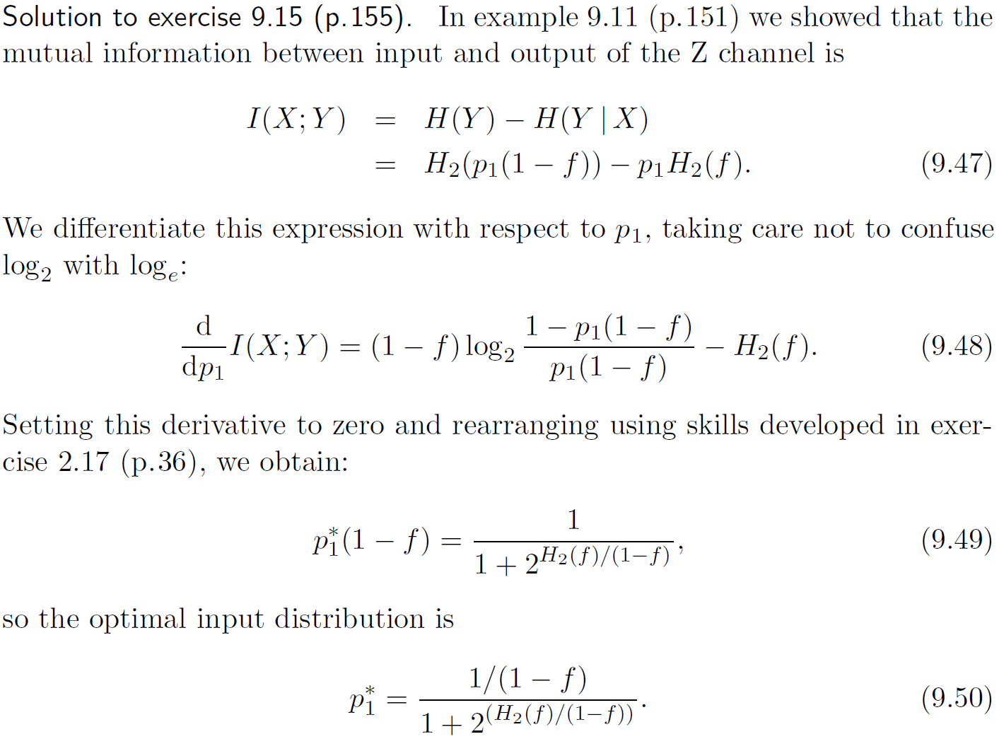
The intuition why $p_{1}^{∗}≤0.5$ is because x= 0 and x = 1 can be treated as two channels, where
x = 0 is zero error and x = 1 is noisy.

Slide 8
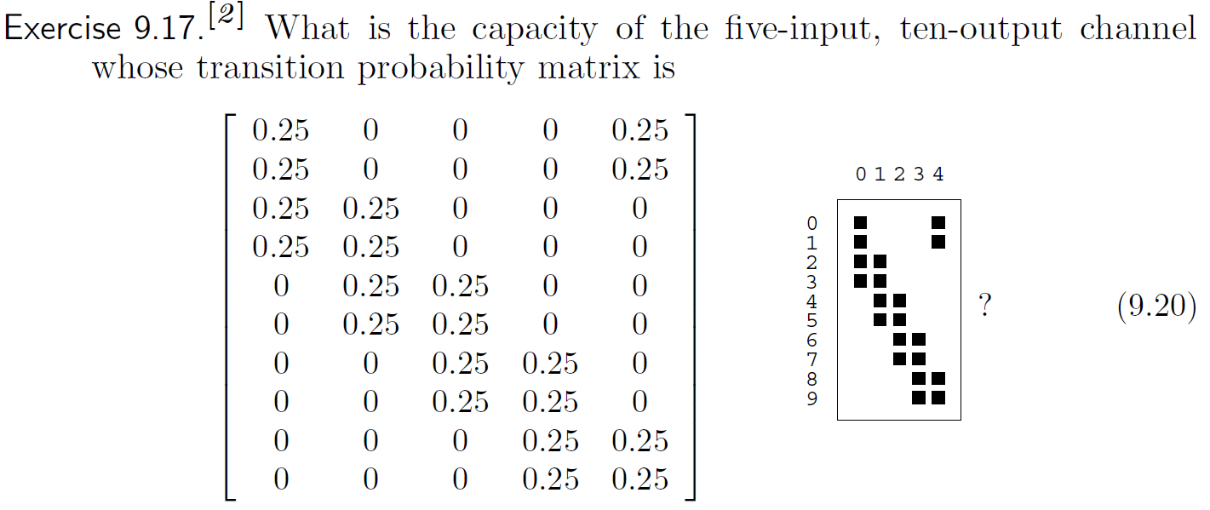
Symmetric Channel

Slide 9
The proof is not required for the level of our course.
However, one should know this result.

Slide 10
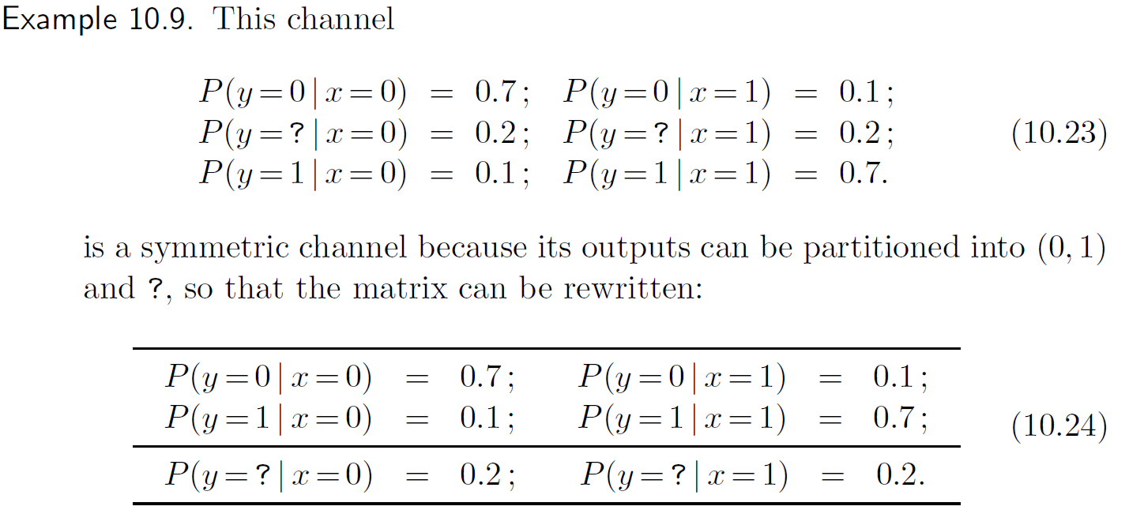
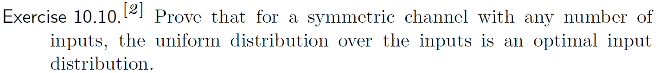

Slide 11
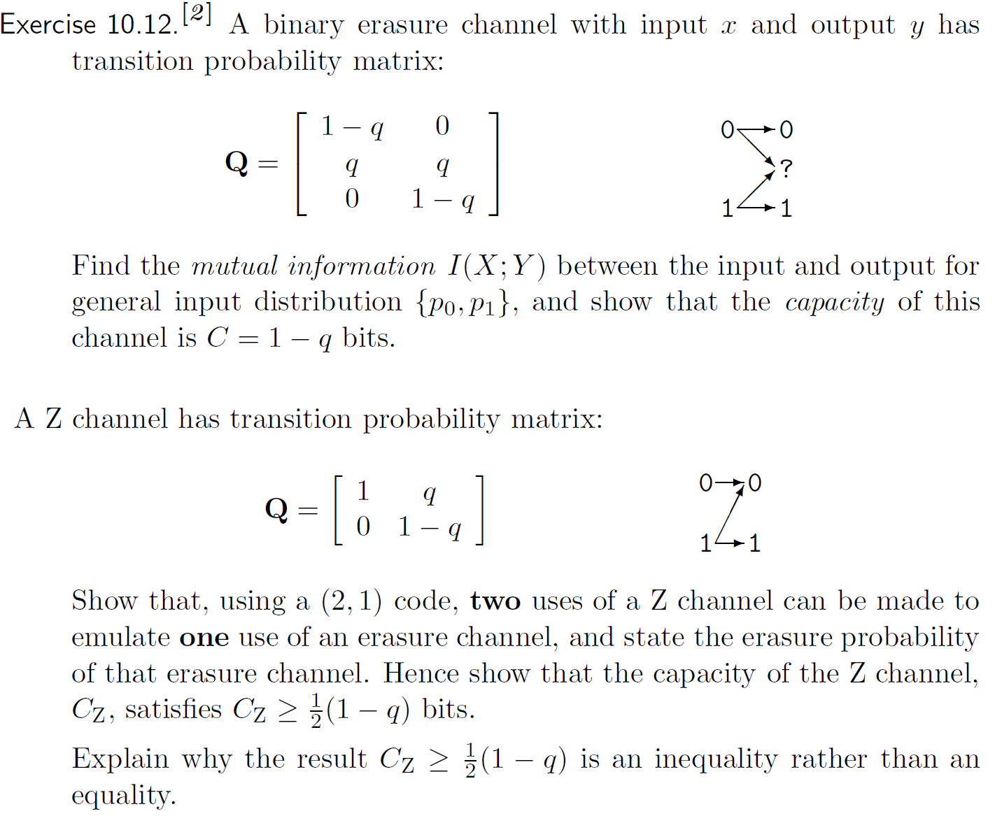

Slide 12
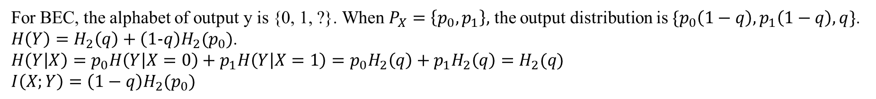
For BEC, the alphabet of output y is {0, 1, ?}. When $P_{X}=\left\{p_{0},p_{1}\right\},$ the output distribution is $\{p_{0}\left(1−q\right), p_{1}\left(1−q\right), q\}$.
$H\left(Y\right)=H_{2}\left(q\right)+\left(1-q\right)H_{2}(p_{0})$.
$H\left(Y | X\right)=p_{0}H\left(Y | X=0\right)+p_{1}H\left(Y | X=1\right)=p_{0}H_{2}\left(q\right)+p_{1}H_{2}\left(q\right)=H_{2}(q)$
$I\left(X;Y\right)=\left(1−q\right)H_{2}(p_{0})$
We design the following code for Z-Channel. For two uses of z-channel, {01, 10}, we have a BEC
with output alphabet {01, 00, 10} and erasure probability q. Hence the channel of BEC is (1-q)/2.
The channel capacity of Z-Channel is at least (1-q)/2.
In the code above, we discard several channels with input like 00, 11. That’s why the lower bound
is hardly possible to attain.

